Slide 1
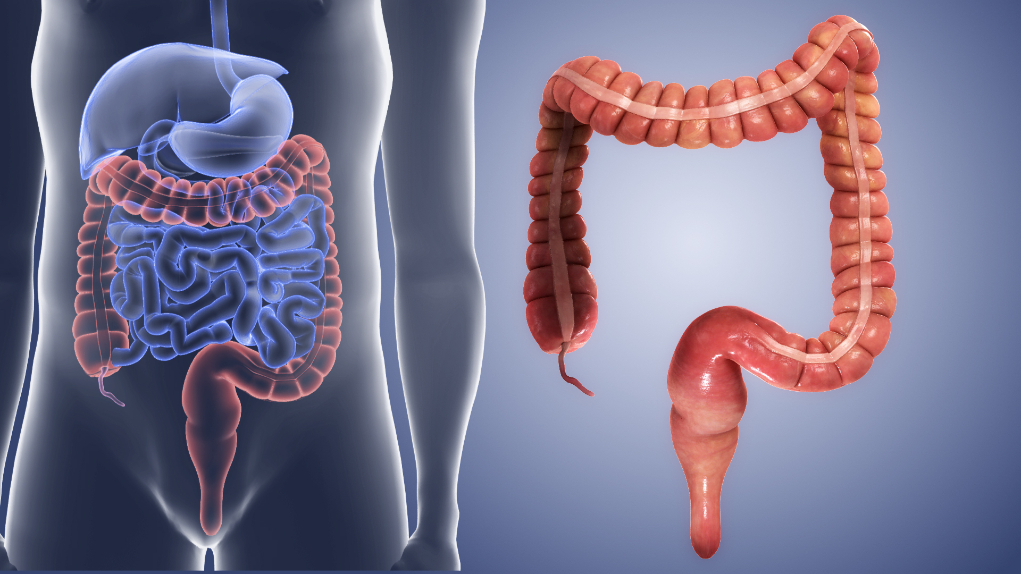
LARGE INTESTINE
LARGE INTESTINE

Slide 2
Functions of the stomach
■ Absorbs water and electrolytes.
■Formation of feces from indigestible materials

Slide 3
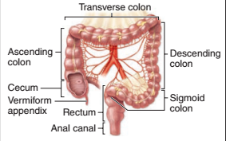
REGIONS OF THE large intestine
The large intestine has three major regions:
1- The short cecum, with the ileocecal valve and the appendix
2- The long colon : with its : ascending,
transverse ,descending and Sigmoid portions
3. The rectum : where feces are stored prior to
evacuation

Slide 4
Character of large bowel
The mucosa lacks villi
no major folds except in the rectum
Less than one-third as long as the small intestine
Greater diameter than small intestine , its diameter of about (6-7 cm)
Presence of haustra which is puckering of the colonic wall into a series of large sacs

Slide 5
Layers of large intestine
The mucosa:
penetrated throughout its length by tubular intestinal glands.
lined by goblet and absorptive cells, with a small number of enteroendocrine cells
The columnar absorptive cells or colonocytes have irregular microvilli and dilated intercellular spaces indicating active ﬂuid absorption
The absorption of water is passive, following the active transport of sodium from the basolateral surfaces of the epithelial cells.

Slide 6
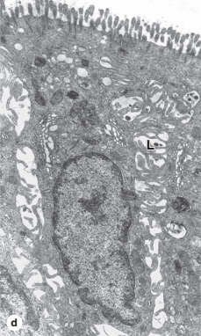
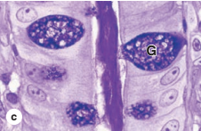
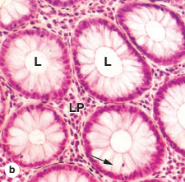
Goblet cells producing lubricating mucus become more numerous along the length of the colon and in the rectum.
Epithelial stem cells are located in the bottom third of each gland.
The lamina propria is rich in lymphoid cells and in
lymphoid nodules that frequently extend into the submucosa
The richness in MALT is related to the large
bacterial population of the large intestine.
The appendix has little or no absorptive function
but is a significant component of MALT

Slide 7
The submucosa:
Highly vascularized especially at the distal end of the rectum, the anal canal.
Swollen blood vessels in the mucosa or submucosa of the anal canal can cause a painful disorder called hemorrhoids.

Slide 8
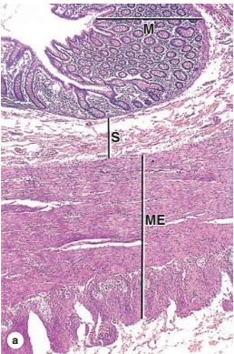
The muscularis
Has two layers
Longitudinal and circular layers
Fibers of the outer layer gathered in three separate longitudinal bands called teniae coli
The teniae coli produce the haustra in the colon wall

Slide 9
The serosa
Intraperitoneal portions of the colon (ascending , descending colon and rectum are retroperitoneal)are covered by serosa
small, pendulous protuberances of adipose tissue.
continuous with that of the supporting mesenteries and displays a series of suspended masses of adipose tissue called omental appendages.

Slide 10
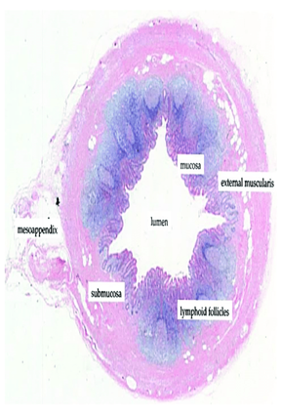
The vermiform appendix
short intestinal protrusion connected to the cecum (a pouch-like structure located at the junction of the small and large intestine
Around 9 cm in length
The inner lining, facing the lumen of the appendix, is covered by a glandular epithelium with intestinal mucus glands that extend into the deeper layers of the mucosa
The glands are lined with epithelial cells (simple columnar epithelium) and a high number of mucin producing goblet cells.
Goblet cells are characterized by a large globule of mucus located in the top portion of the cell.

Slide 11
The lamina propria typically contains lymphocytes that partly obscure the underlying muscularis mucosae, which separates the mucosa from the submucosa.
The submucosa is almost fully occupied by lymphoid tissue mainly arranged in primary and secondary lymphoid follicles.
The lymphoid follicles are recognized by a circular aggregation of densely packed lymphocytes
The center of the secondary lymphoid follicles stain lighter and are termed germinal centers.
The outer portions of the submucosa harbor larger vessels and have less dense infiltrates of immune cells.
Similar to the colon, an inner circular muscle layer and a thin external longitudinal muscle layer comprise the muscularis externa that encircles the appendix.
Outside of the muscular layers there is a serosa containing loose connective tissue, vasculature and nerves.
The outermost located peritoneum consists of a thin lining of mesothelial cells.

Slide 12
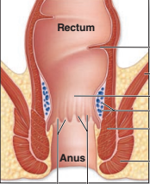
The rectum , the Rectoanal junction and the Anus
The rectum lined by simple columnar epithelium
with tubular intestinal glands.
The distal end of the GI tract is the anal canal, 3-4 cm long.
At the rectoanal junction the simple columnar mucosal lining of
the rectum is replaced by stratifed squamous epithelium
The mucosa and submucosa of the anal canal form several longitudinal folds, the anal columns, in which the lamina propria and submucosa include sinuses of the rectal venous plexus.

Slide 13
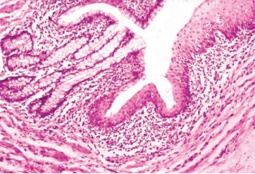
Near the anus the circular layer of the rectum’s muscularis forms the internal anal sphincter.
Defecation involves the action of voluntary striated muscle comprising the external anal sphincter
The connective tissue of the lamina propria is seen to contain many free lymphocytes

Slide 14
THANKS

